Slide 1
HEALTHCARE INFORMATION SYSTEM

Slide 2
Table of contents
Objective
Problem Statement
Architecture
Hardware/Software requirements
Implementation
Results- Screen Shots of Output
Conclusion

Slide 3
objective
The healthcare information system is a Django-based web app designed to digitize and streamline processes within healthcare facilities. It includes patient registration, employee management, appointment scheduling, pharmacy operations, prescription management, and lab test tracking. Built on Django's MVC architecture, it ensures secure access with user authentication. Patients can schedule appointments and access prescription history, while healthcare professionals manage patient records, prescriptions, tests, and pharmacy inventory. This system enhances efficiency, reduces manual work, and improves patient care.

Slide 4
Purpose of the project
The primary purpose of the healthcare information system is to digitize and automate various processes within a healthcare facility, thereby enhancing operational efficiency, streamlining workflows, and improving overall patient care. By incorporating modern technology into the healthcare ecosystem, the system aims to address the challenges posed by traditional paper-based or disparate systems, which often lead to inefficiencies, data inconsistencies, and delays in information sharing among different departments and healthcare professionals.

Slide 5
Architecture
The healthcare information system follows a client-server architecture, with Django as the web framework on the server-side. The system is built using Python and adheres to the Model-View-Template (MVT) architectural pattern. The models define the database schema, representing entities like patients, employees, and appointments. The views handle the application logic, processing user interactions and data manipulation. The templates render the user interface, facilitating seamless interaction between clients (web browsers or mobile apps) and the server. The system leverages Django's built-in features for user authentication, form handling, and URL routing, while integrating with third-party libraries for PDF generation and other functionalities.

Slide 6
Hardware/Software requirements
Hardware Requirements:
Server Machine
Internet Connection
Software Requirements:
Operating System
Python 3
Django framework
Web browser

Slide 7
implementation
The healthcare information system employed the Django web framework, adhering to the Model-View-Template (MVT) architecture. Models representing core entities were defined using Django's Object-Relational Mapping (ORM). Views handled application logic, user interactions, and data processing. Templating engine rendered user interfaces with HTML, CSS, and JavaScript. User authentication leveraged Django's built-in system and third-party libraries like django-allauth. PDF generation utilized reportlab library for reports and bills. The system was deployed on a Linux server environment, with Apache as the web server and PostgreSQL for database management. Version control with Git facilitated collaborative development, while containerization with Docker streamlined deployment processes.

Slide 8
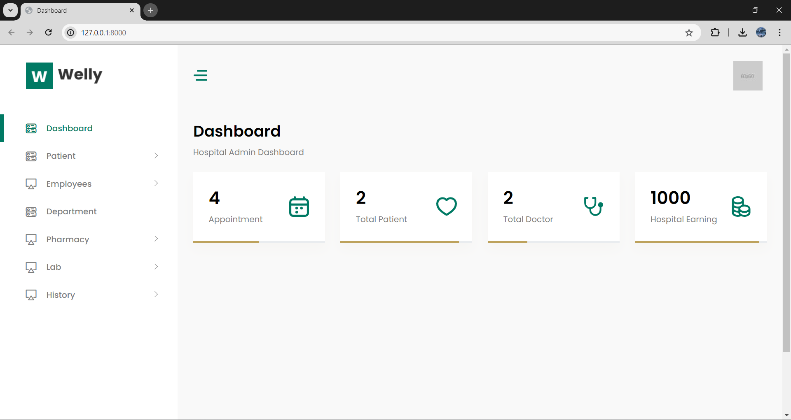
result

Slide 9
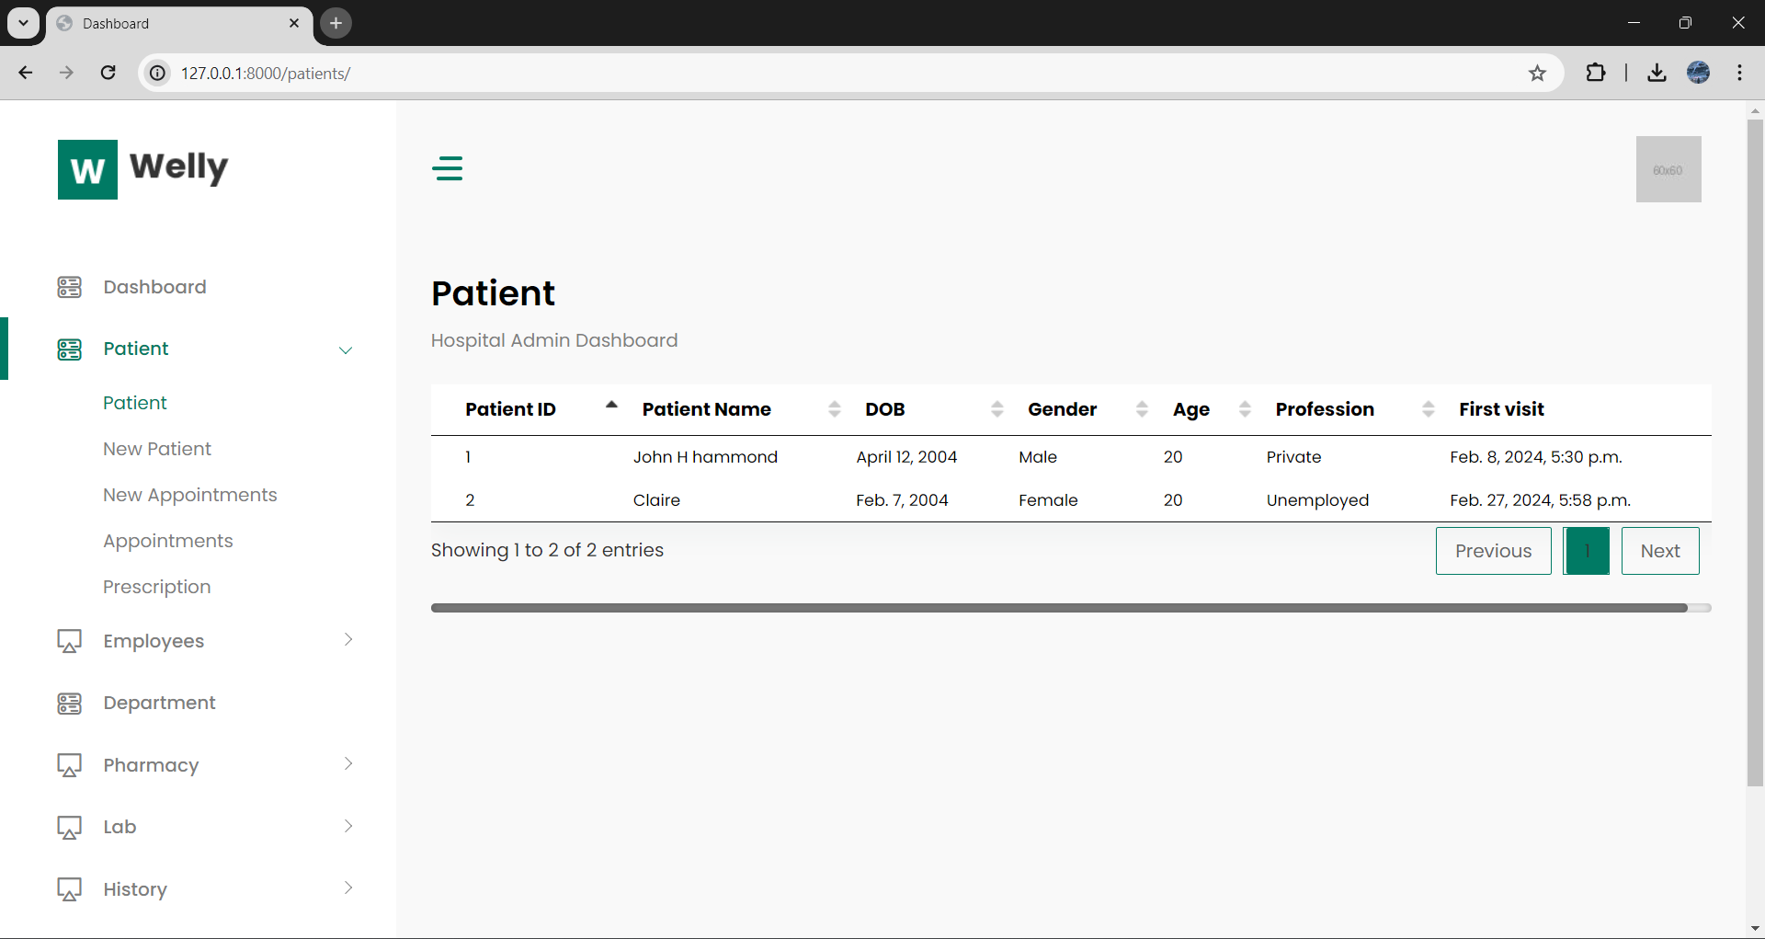
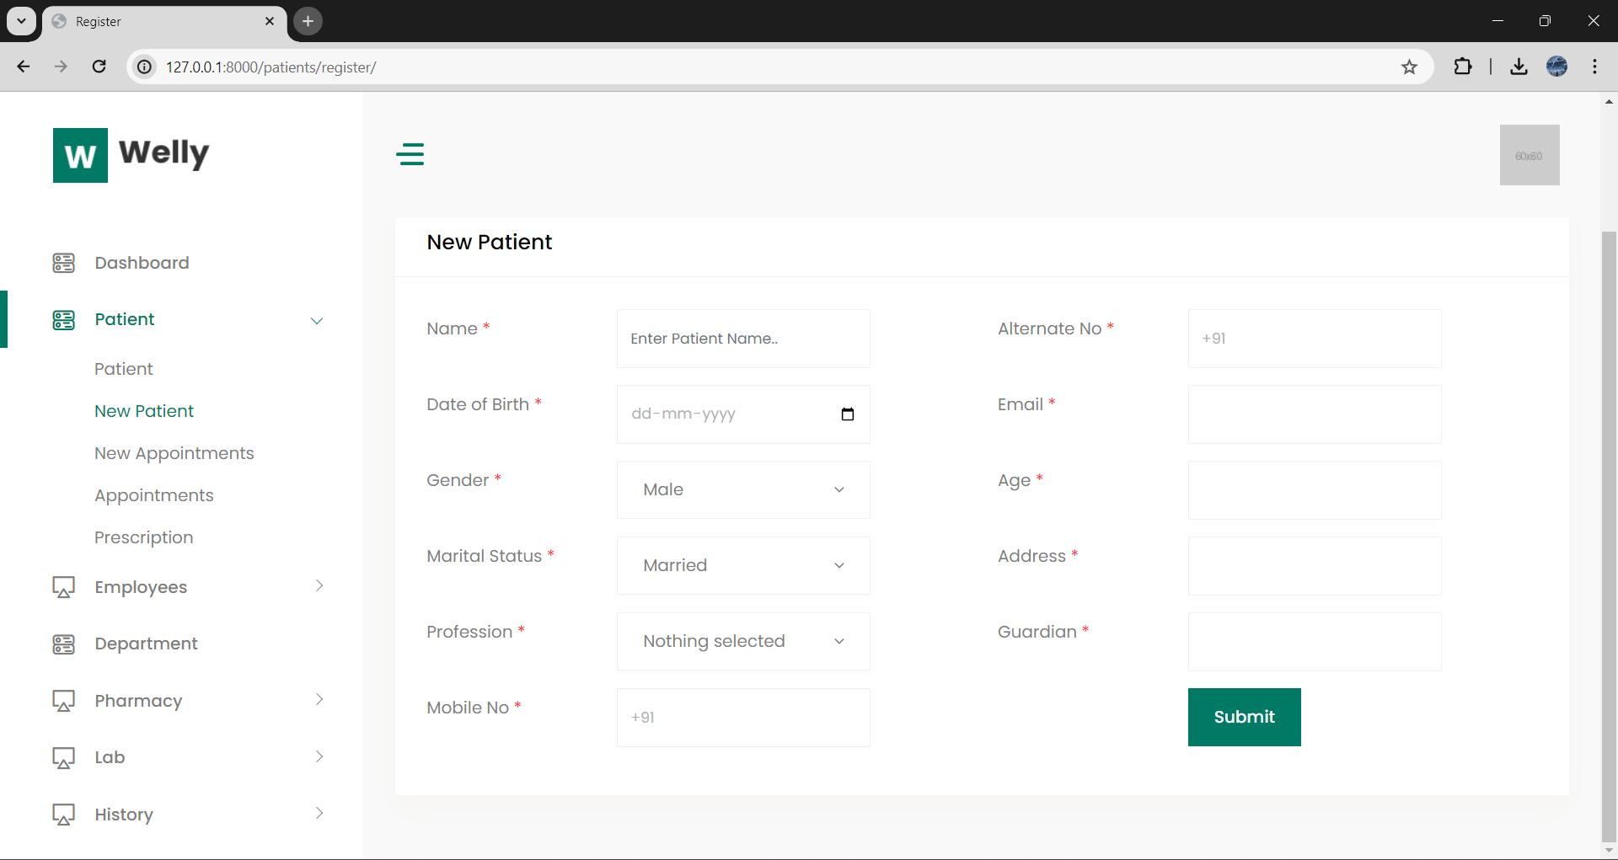
result

Slide 10
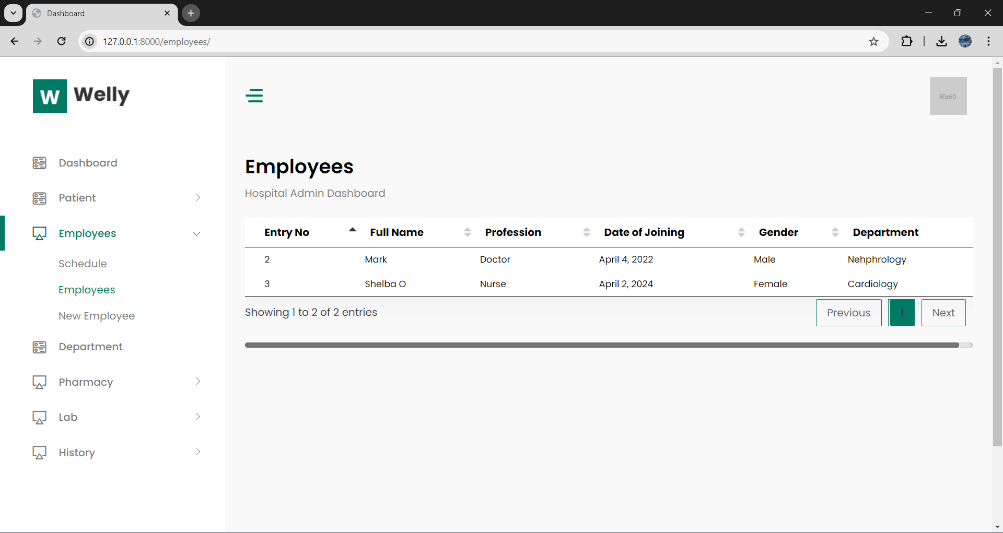
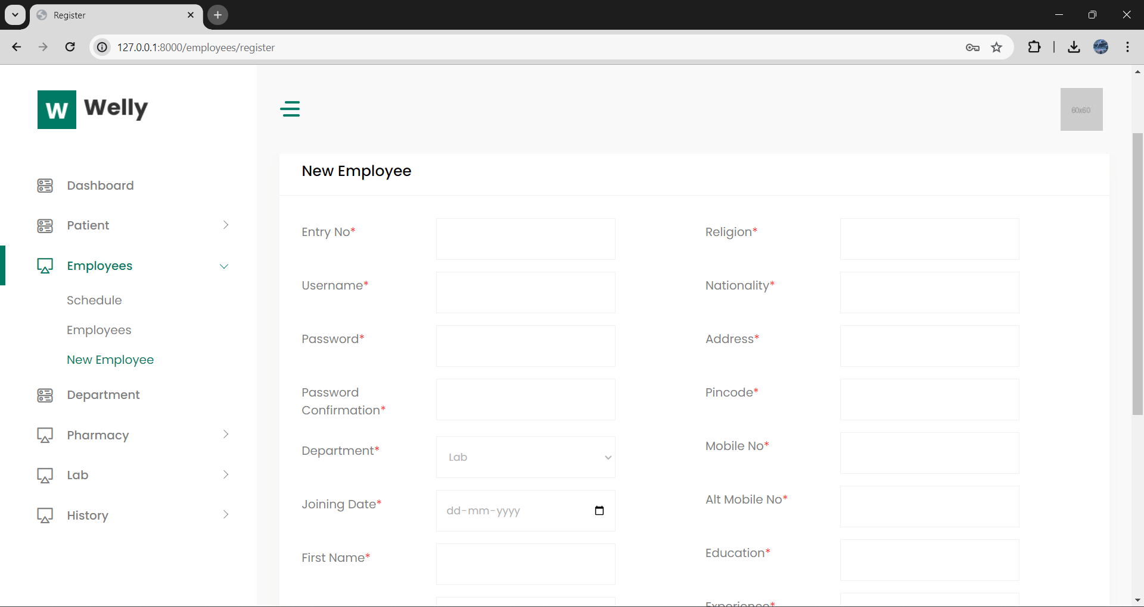
result

Slide 11
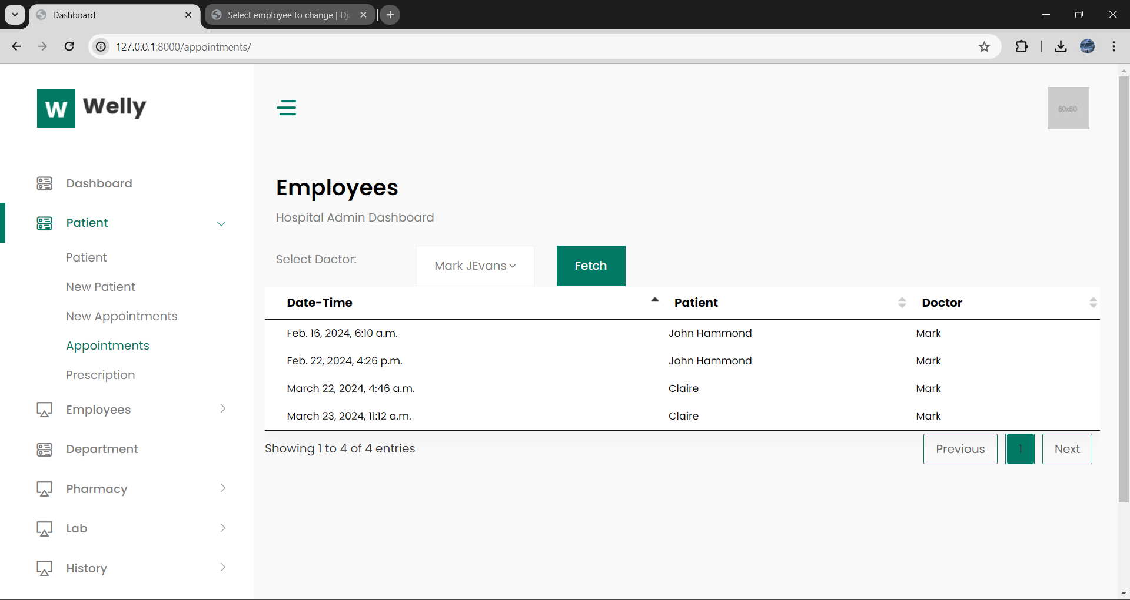
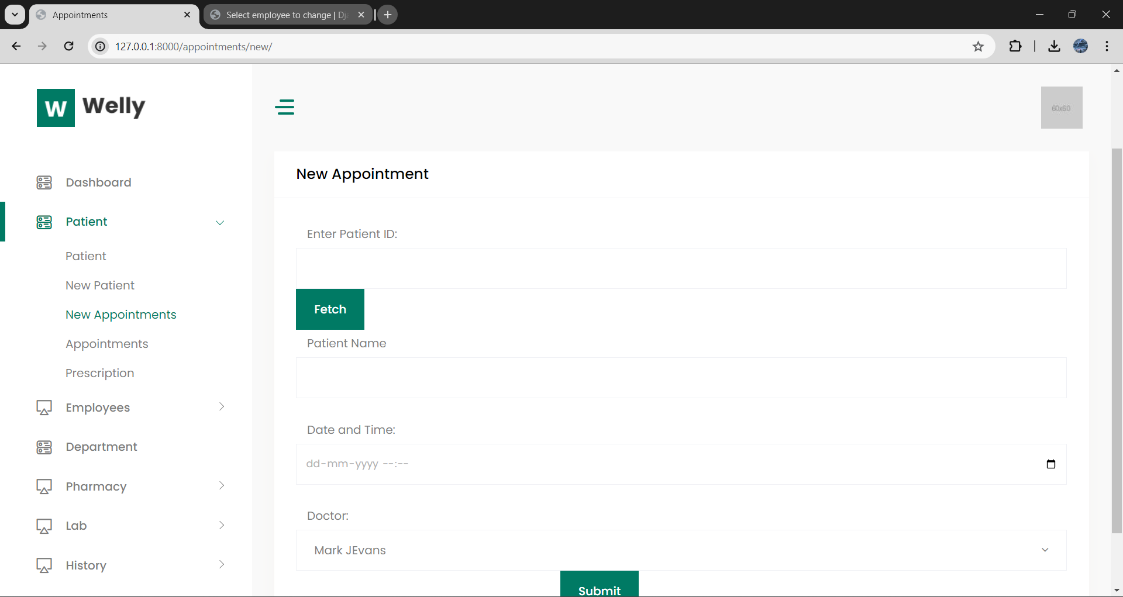
result

Slide 12
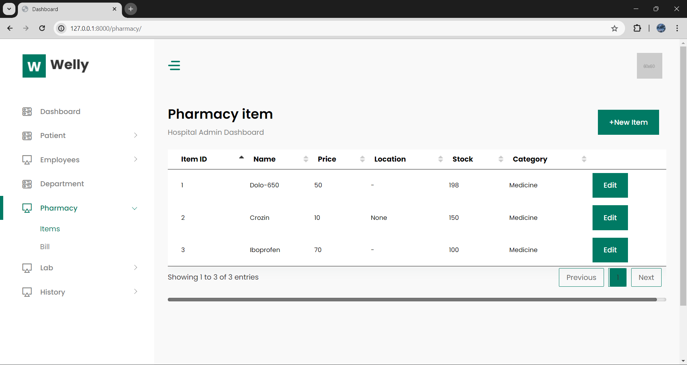
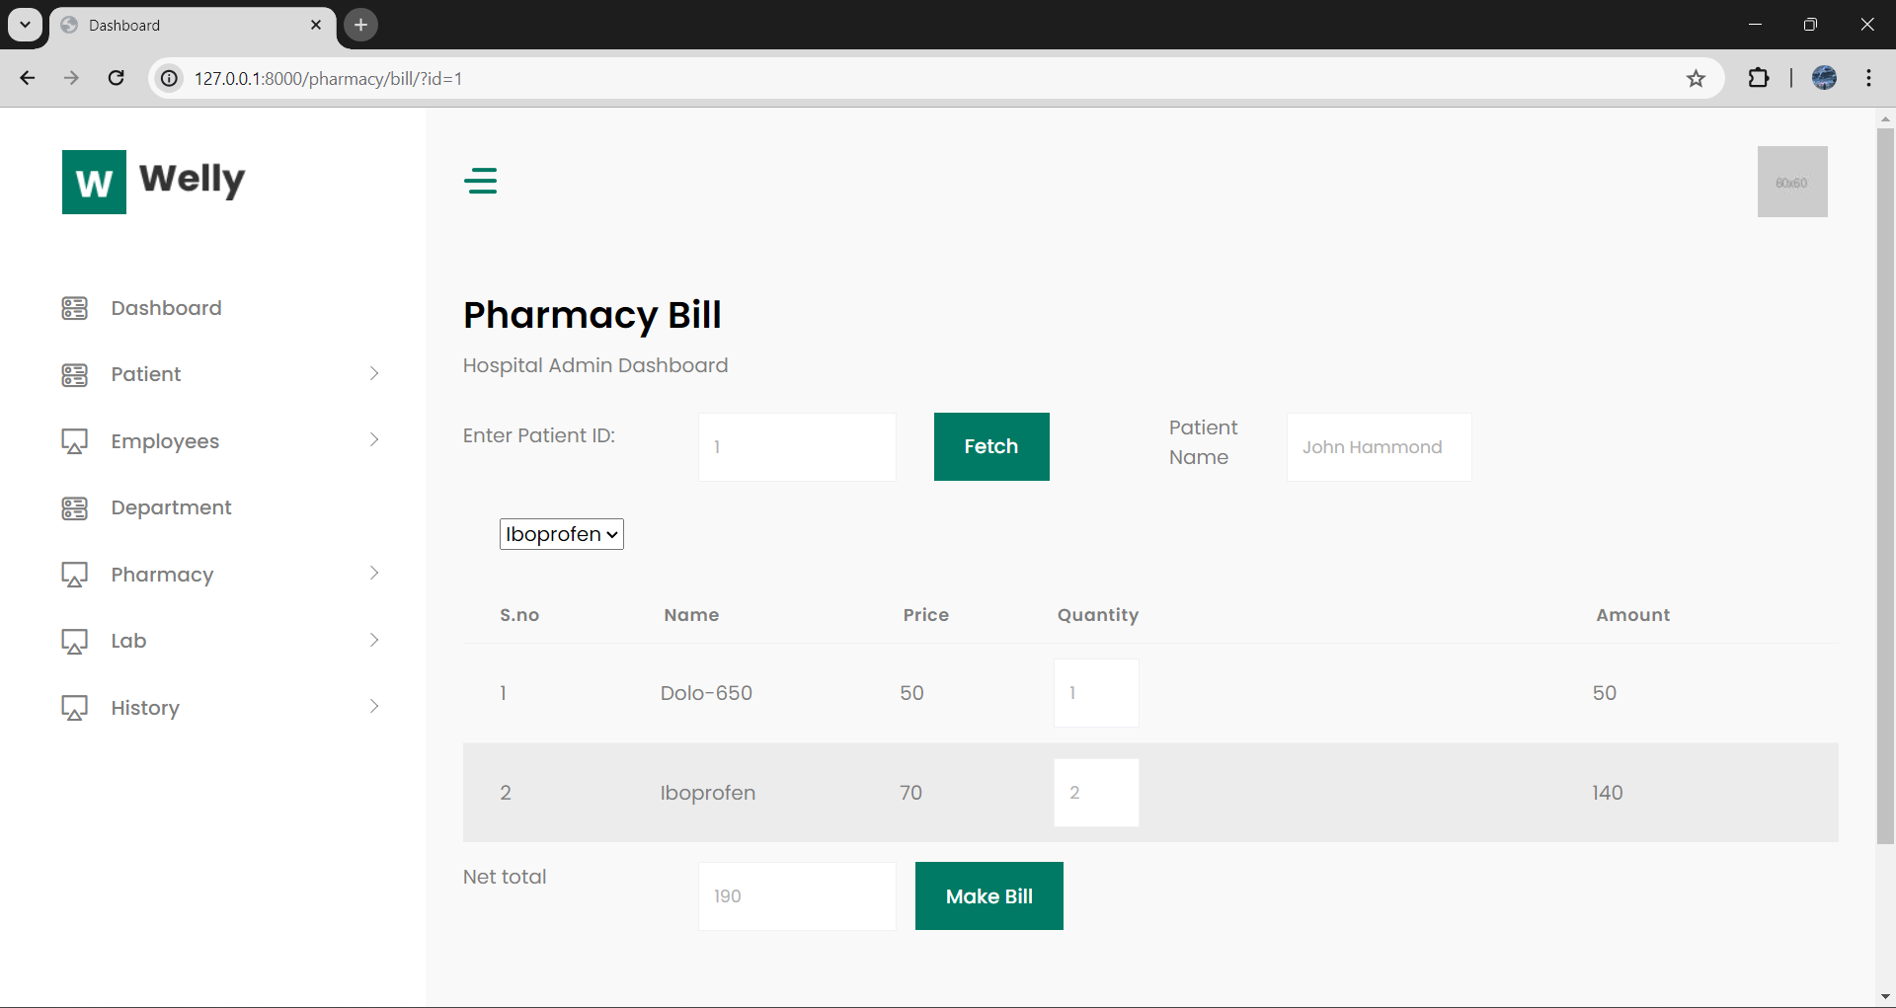
result

Slide 13
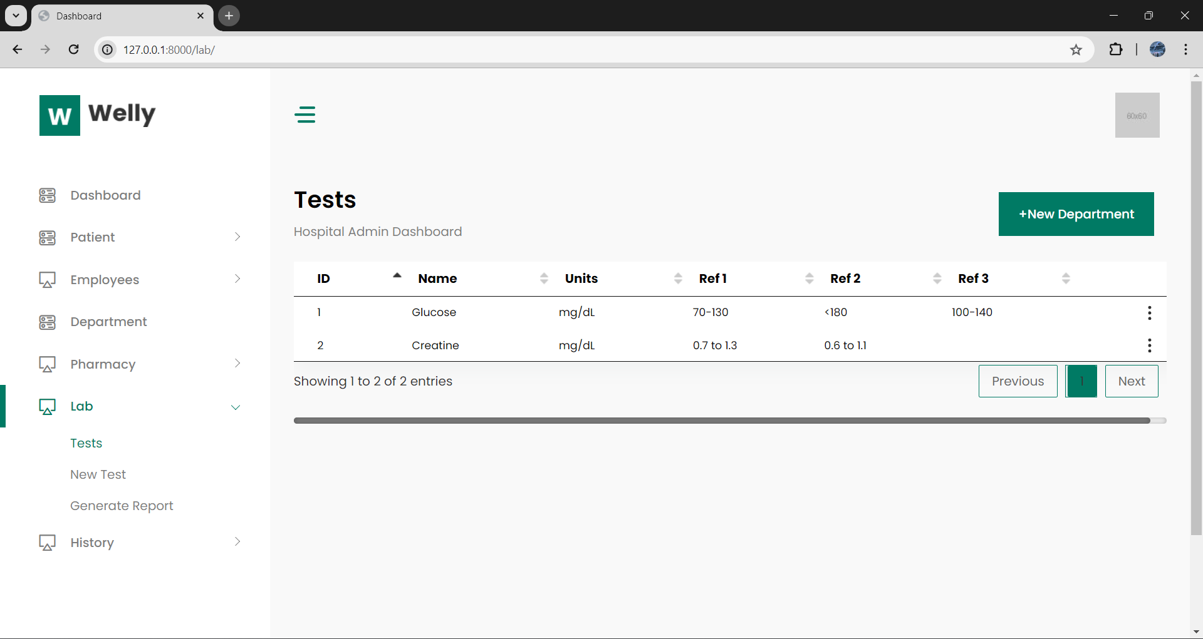
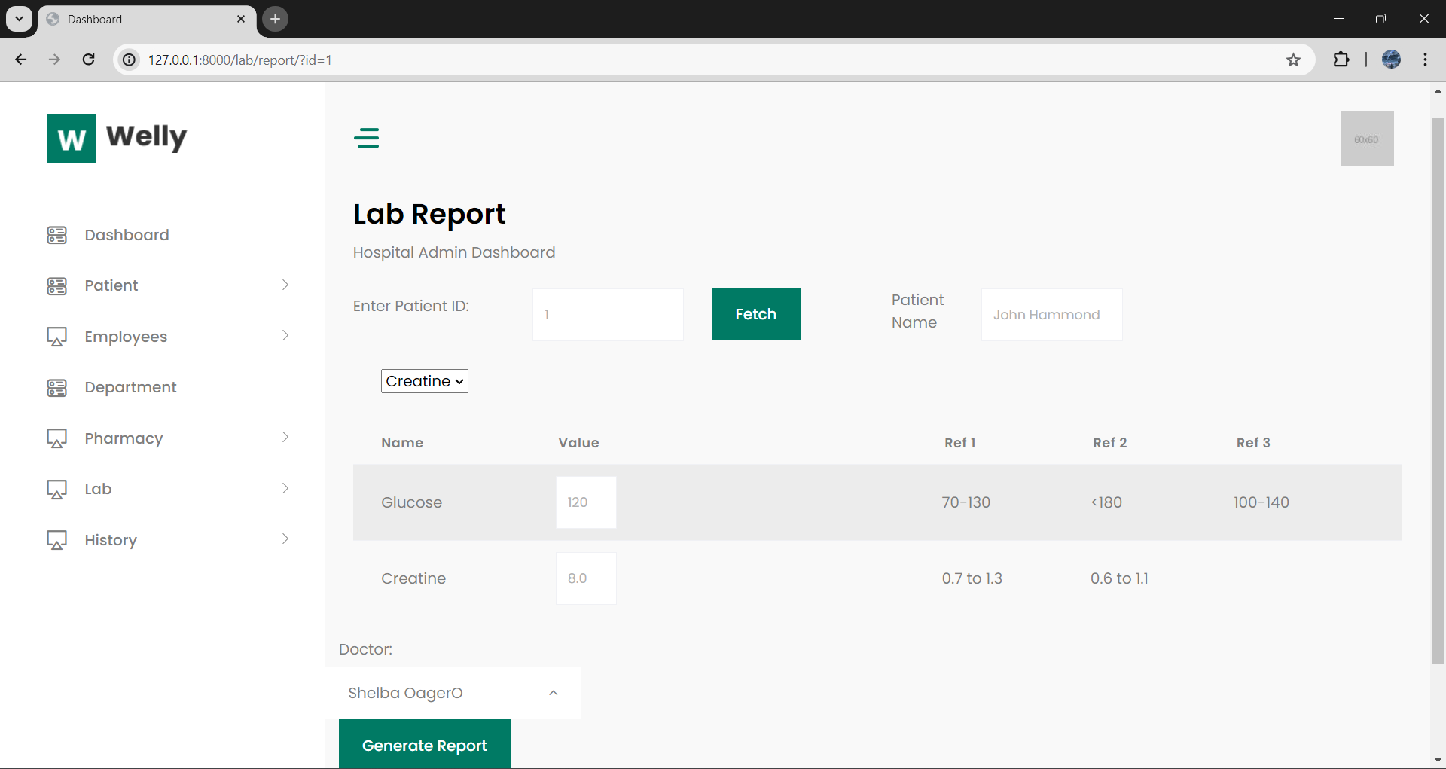
result

Slide 14
conclusion
The healthcare information system project has successfully delivered a comprehensive digital solution that addresses the challenges faced by traditional paper-based or disparate systems in the healthcare domain. By leveraging modern technologies like the Django framework and following best practices in software development, the system streamlines processes, enhances data accuracy, and facilitates seamless collaboration among healthcare professionals and departments. With its modular architecture, secure access controls, and user-friendly interfaces, the system paves the way for improved patient care, operational efficiency, and data-driven decision-making. While there is room for further enhancements and integrations, the project lays a solid foundation for digitizing healthcare processes and embracing the benefits of technology in the pursuit of better healthcare outcomes.

Slide 15
THANK YOU
SAM FREDRICK (RA2211030010072)
CHITHRESH (RA2211030010073)
REDDY ROTHITH (RA2211030010078)

